Slide 1
Differential Gene Expression Analysis between Primary and Metastatic States in Osteosarcoma Patients Using Secondary RNA-Seq Dataset (GSE220538)
Razmia Sabahat Butt

Slide 2
Osteosarcoma
Definition
Type of Bone Cancer
Epidemiology
800 new cases reported each year in US
Develops in Osteoblasts
Accounts for 3% of all the childhood cancers
Symptoms
Pain in the affected bone
Swelling
Limping
Difficulty in movement
Diagnosis
X-Rays
Bone Scans
MRI

Slide 3
Objectives of Analysis
Analyze DEGs during primary and metastatic states of Osteosarcoma
Identify the pathways associated with DEGs

Slide 4
Dataset
Homo sapiens
Contain primary and metastatic samples
No treatment-related samples
GSE220538
16 Samples
(Primary tumor = 8
Metastatic tumor = 8)

Slide 5
Analysis Pipeline
Data Import (Galaxy)
Removing Duplicates (MarkDuplicates & RmDup)
Assembly into transcripts (StringTie)
DEG Analysis (Ballgown)
Quality Check (FastQC)
Quality Control (fastp)
Alignment (HISAT2) CHM13_T2T_v2.0
Pathway Analysis (Enrichr)
Enrichment Analysis (Clusterprofiler)

Slide 6
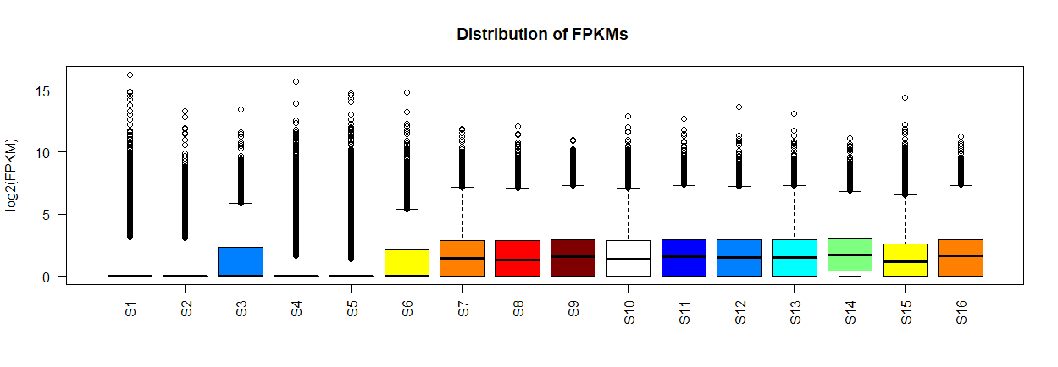
Features of Dataset
Distribution of FPKM Values across different samples

Slide 7
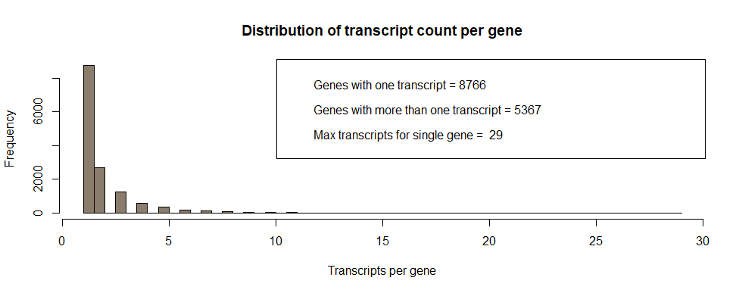
Features of Dataset
Distribution of Transcripts Numbers per Gene

Slide 8
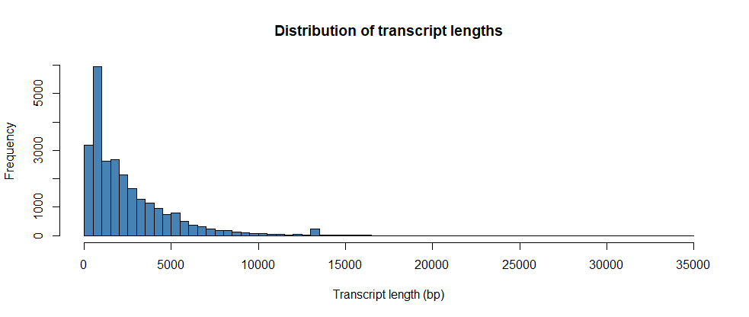
Features of Dataset
Distribution of Transcript Length

Slide 9
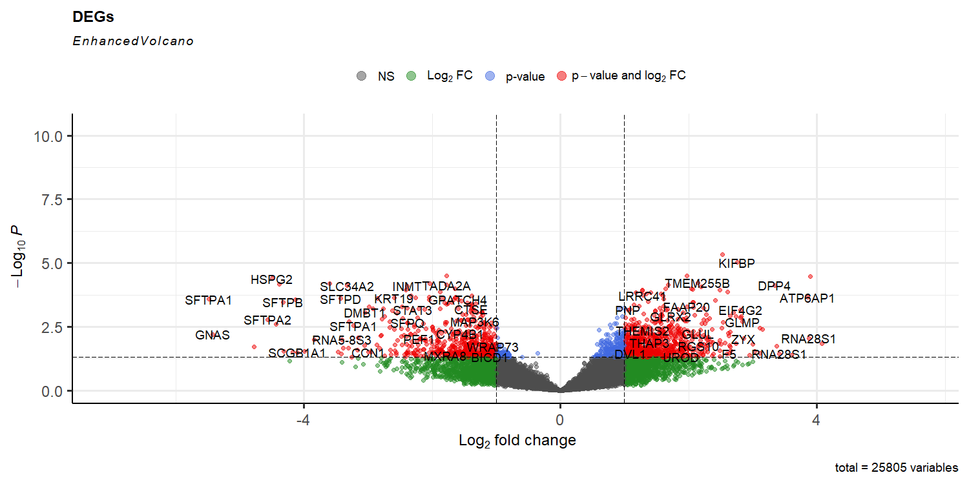
Differentially Expressed Genes (DEGs)
Volcano Plot showing DEGs
P-value Cutoff = 0.05
Fold Change (FC) Cutoff = 1.0

Slide 10
Number of DEGs
Total DEGs = 1202
Upregulated = 683
Downregulated = 548
P-value Cutoff = 0.05
-1 < Log2 FC (DE) Cutoff > 1
P-value Cutoff = 0.05
Log2 FC (DE) Cutoff > 1
P-value Cutoff = 0.05
-1 < Log2 FC

Slide 11
DEGs
Genes | Gene ID | Fold Change (FC) | P-value | DE (log2FC)
DVL1 | G0000063 | 2.143552684 | 0.034508 | 1.100003876
MXRA8 | G0000065 | 0.287143584 | 0.042581 | -1.800155768
MMP23B | G0000090 | 0.454523589 | 0.035273 | -1.137572925
FAAP20 | G0000112 | 3.91363606 | 0.000512 | 1.968509602

Slide 12
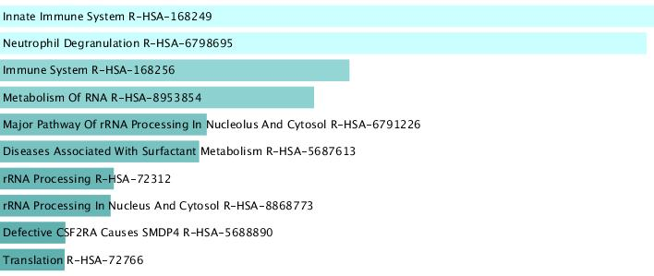
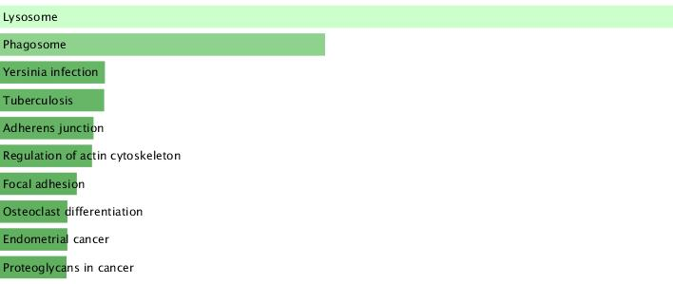
Pathway Analysis (Enrichr)
Genes present in Reactome Pathway
Genes present in KEGG Pathway
[1] Sheng, G., Gao, Y., Yang, Y., & Wu, H. (2021). Osteosarcoma and metastasis. Frontiers in oncology, 11, 780264.
[2] Shao, H., Ge, M., Zhang, J., Zhao, T., & Zhang, S. (2022). Osteoclasts differential-related prognostic biomarker for osteosarcoma based on single cell, bulk cell and gene expression datasets. BMC cancer, 22(1), 288.
[3] Chen, X., Ye, Z., Lou, P., Liu, W., & Liu, Y. (2021). Comprehensive analysis of metabolism-related lncRNAs related to the progression and prognosis in osteosarcoma from TCGA. Journal of Orthopaedic Surgery and Research, 16, 1-13.
Notes:
Immune system, both innate and adaptive immune systems are known to be disturbed during metastasis of osteosarcoma. Some immune cells inhibit metastasis while other may promote it [10.3389/fonc.2021.780264]. Additionally, the metabolic pathways are disturbed and are known to play a key role in metastasis [https://doi.org/10.1186/s13018-021-02647-4]. Genes responsible for Osteoclast differentiation have been analyzed by researchers and are tested for their prognostic biomarker potential [10.1186/s12885-022-09380-z].

Slide 13
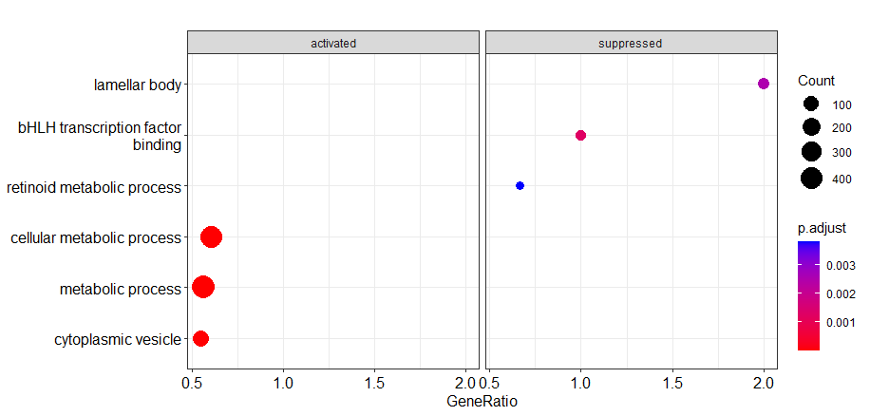
Enrichment Analysis
Group of Genes Enriched in Certain Pathways
[1] Tang, G., Liu, L., Xiao, Z., Wen, S., Chen, L., & Yang, P. (2021). CircRAB3IP upregulates twist family BHLH transcription factor (TWIST1) to promote osteosarcoma progression by sponging miR-580-3p. Bioengineered, 12(1), 3385-3397.
[2] Diao, C., Xi, Y., & Xiao, T. (2018). Identification and analysis of key genes in osteosarcoma using bioinformatics. Oncology letters, 15(3), 2789-2794.
Notes:
Three different studies report that bHLH transcription factor gene is upregulated in osteosarcoma patients, and different microRNA and circularRNA promote the transcription of this gene.

Slide 14
Conclusion
Original Study
673 DEGs (p-value < 0.01 and FC = 1.5)
Androgen Receptor (AR) upstream regulator of lung metastasis
Analysis
1202 DEGs (p-value < 0.05 and FC = 1)
ALDH1A1 gene not identified
Downstream analysis: gene of osteosarcoma metastasis

Slide 15
Acknowledgement
The dataset, GSE220538, have been obtained from GEO NCBI.
Contributors: Weiss K, Heim T
University of Pittsburgh, Pittsburgh, USA.

Slide 16
Thank You

